Slide 1
Agenda
Self Intro
Player Behavior Clustering
Churn Prediction

Slide 2
Why does size matter ?

Slide 3
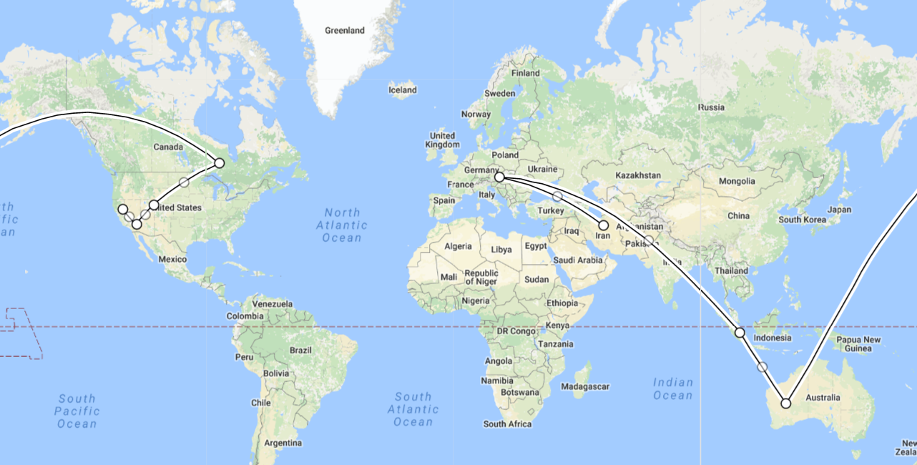
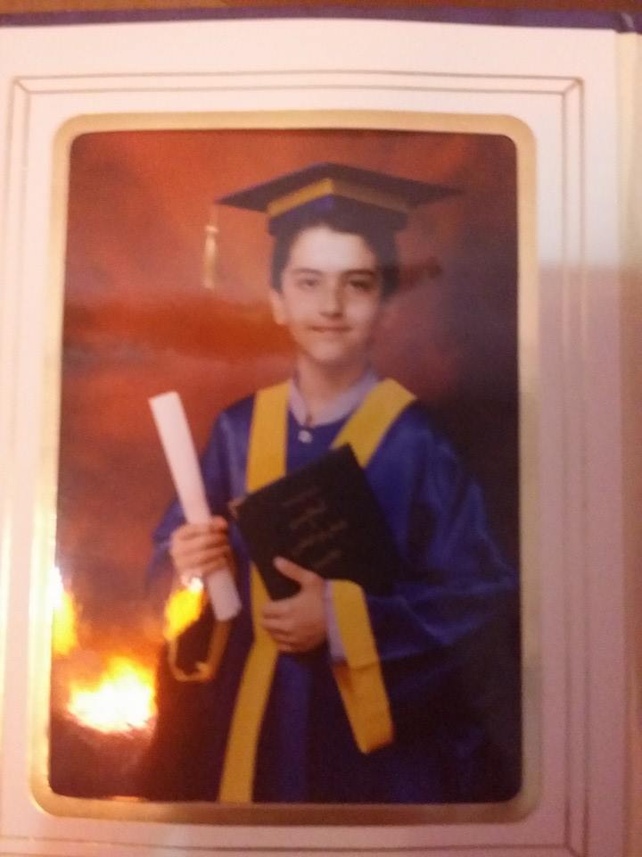
Seyed Sajjadi
Notes:
Fade-out

Slide 4
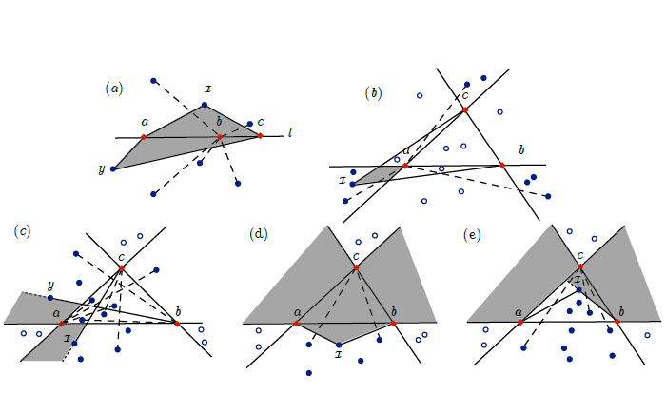
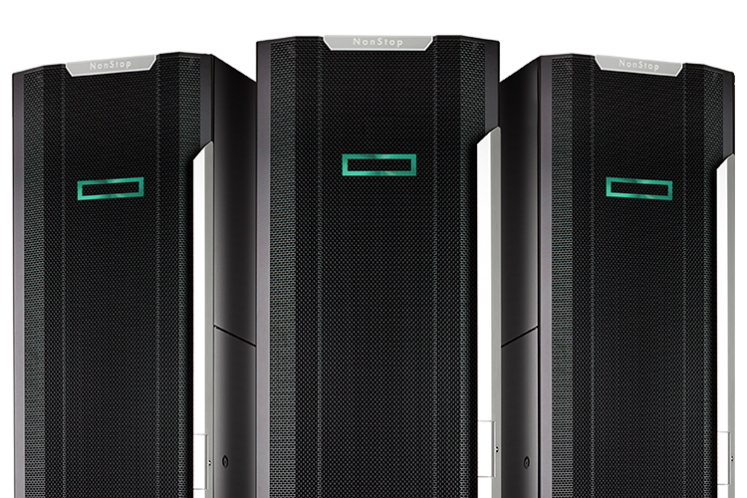
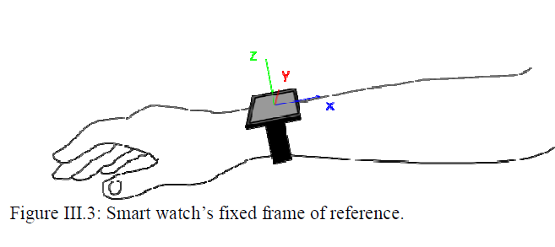

Slide 5
What are the player types and how do they evolve?
WHAT IS THE PROBLEM ?!

Slide 6
Weekly Behavioral Tables
inst_date
player_id
weekly_logins
weekly_rev
light_attmpts
dark_attmpts
cantina_attmpts
pvp_attmpts
gw_attmpts
challenge_attmpts
event_attmpts
raid_attmpts
mtx
cluster0
K- Means
cluster2
cluster1

Slide 7
Cluster 0
Cluster 0
Cluster 0
Cluster 1
Cluster 1
Cluster 1
Cluster 2
Week0
week1
Week2
Notes:
Fade-out display the describtion

Slide 8
“A Sankey diagram is a graphic illustration of flows, like energy, material or money flows. Usually the flows are illustrated as arrows. The width of the arrows is proportional to the size of the represented flow.”

Slide 9
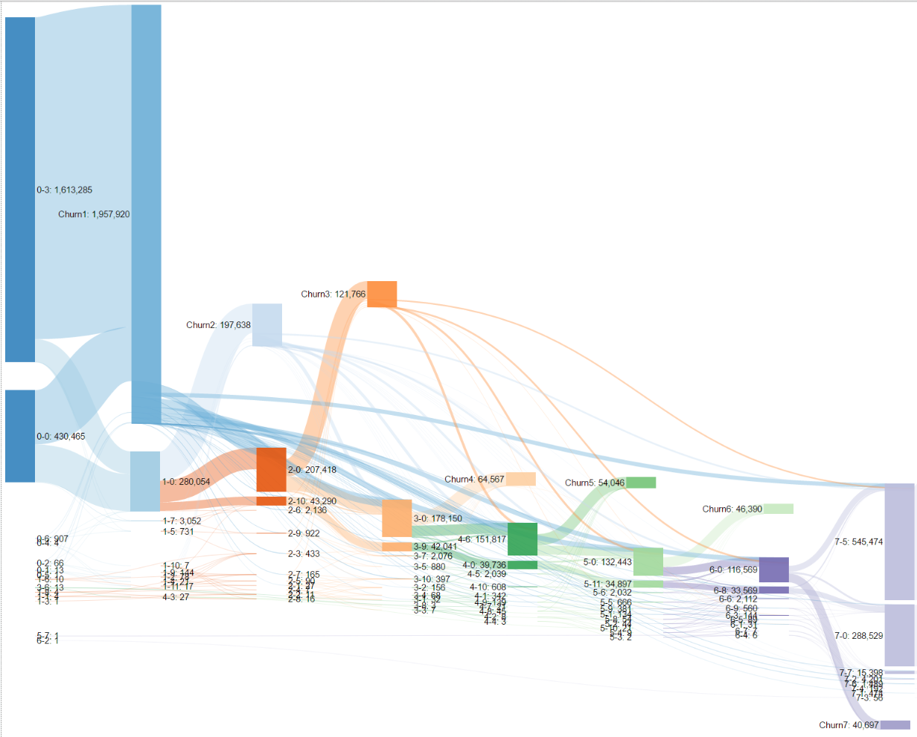
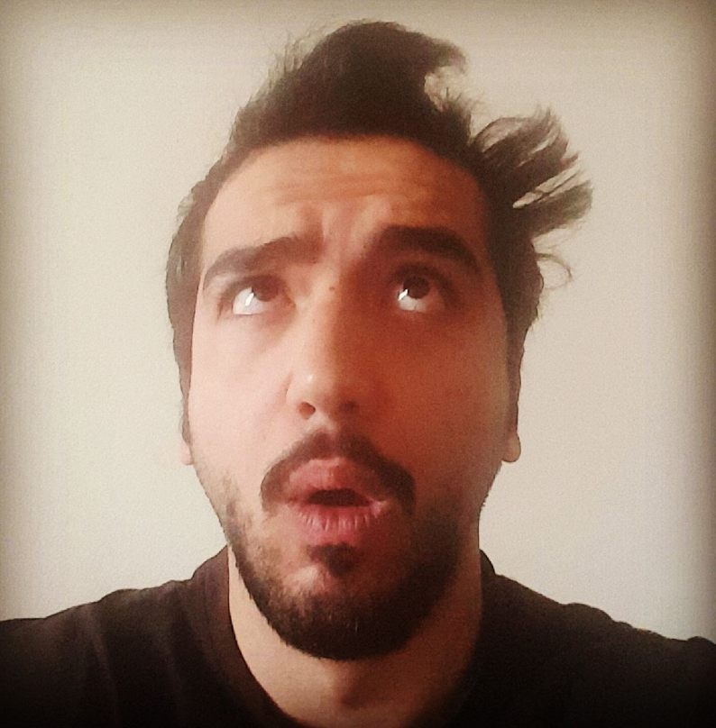

Slide 10
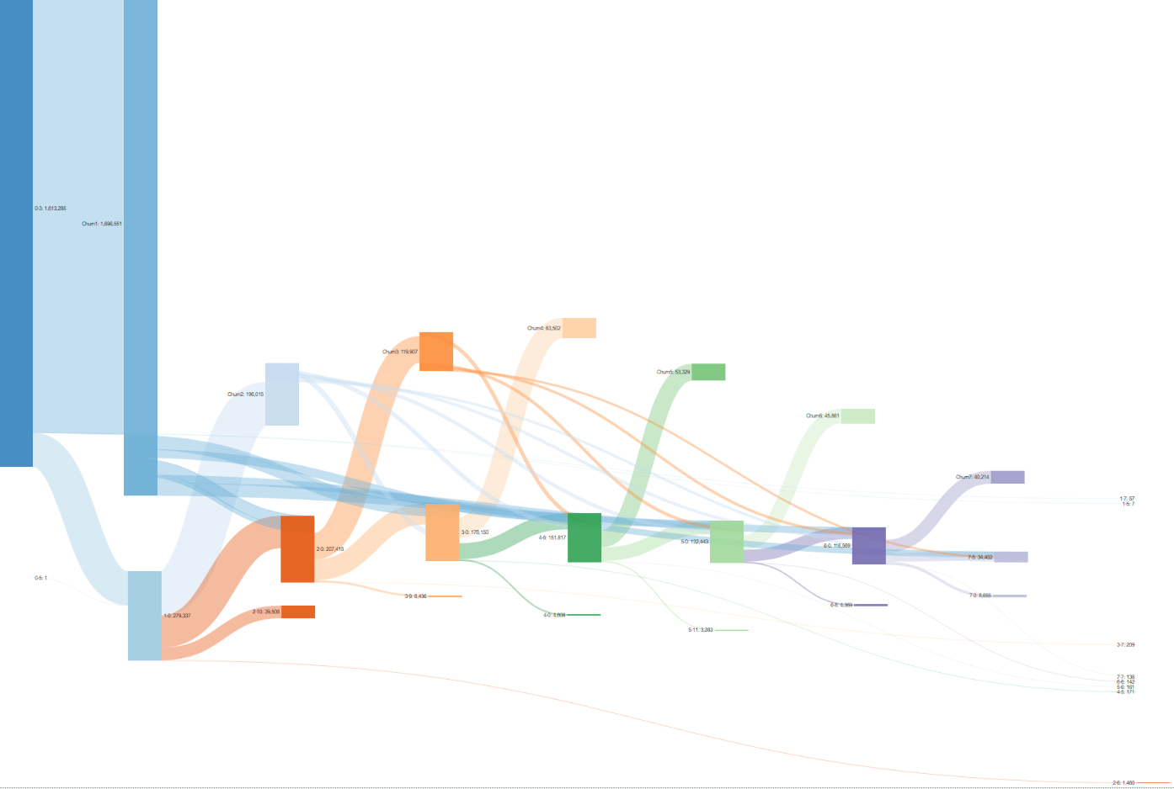
Non- Spenders Life Cycle Sankey

Slide 11
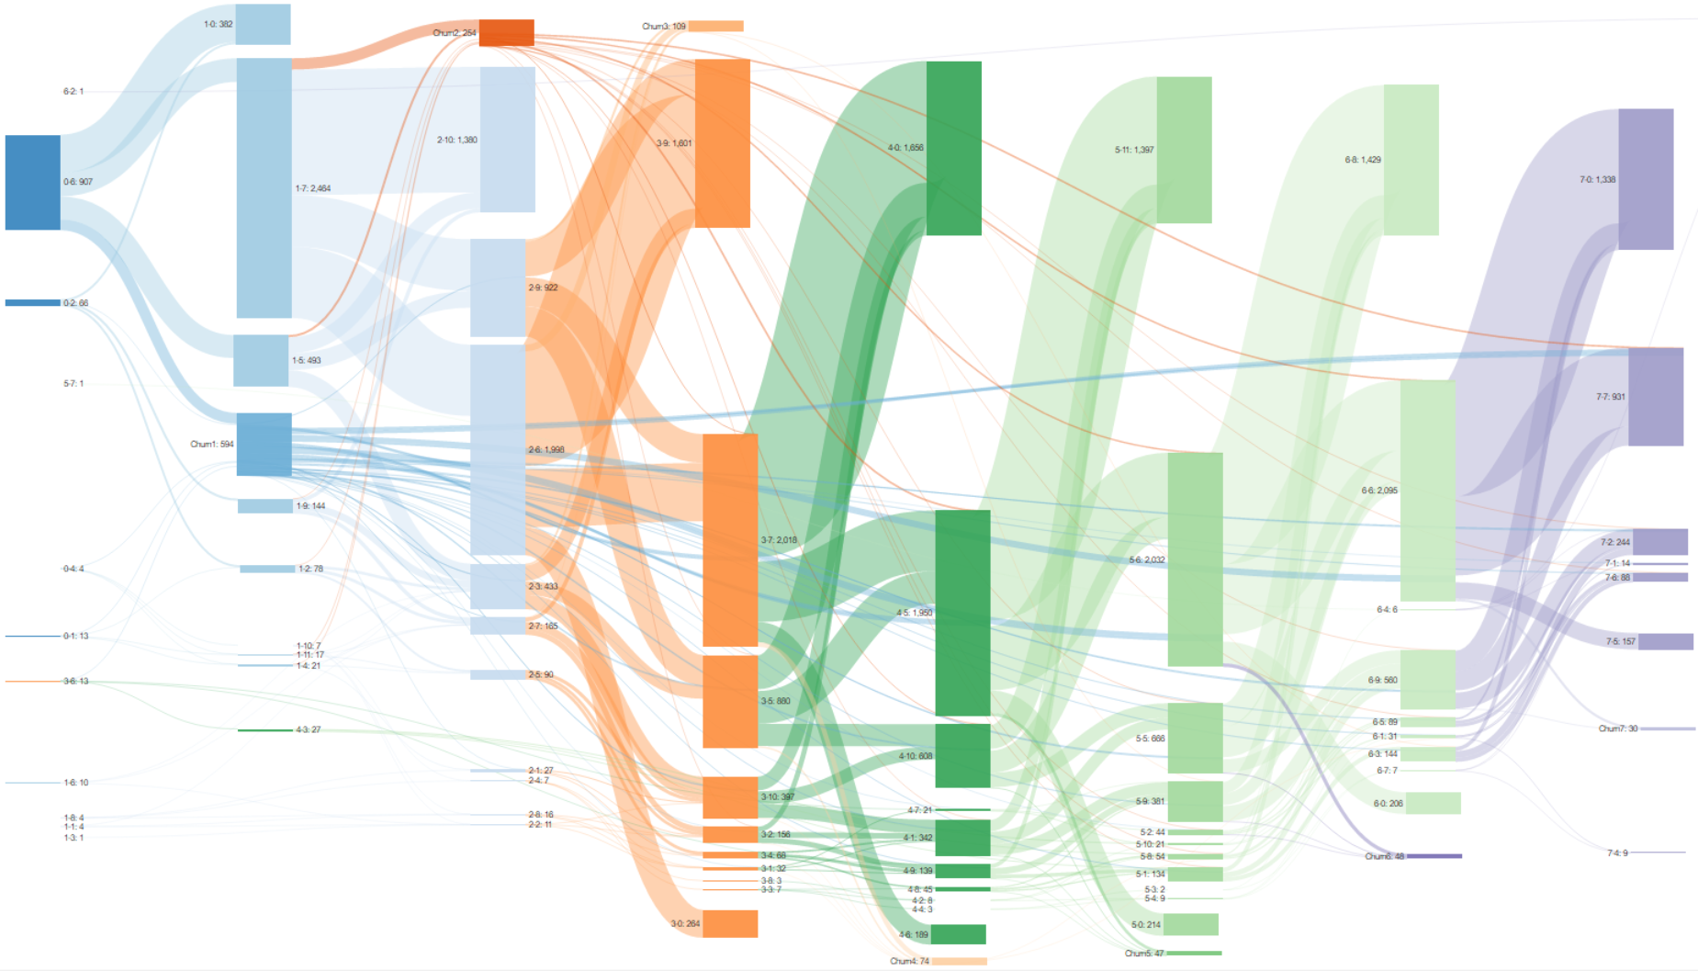
Spenders Life Cycle Sankey

Slide 12
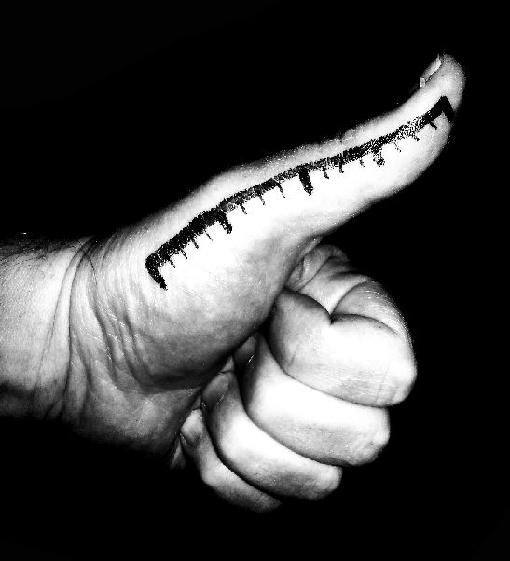
Rules of Thumb
Week 1,2,3 are the only churners with a possibility of returning to the game.
Lost values of spending is the highest in week 2,7,8
First time spenders do not make a meaningful spend after week 4
If players spend after week 4, they will not spend again.
After week 2, players do not change spend patterns
Notes:
heading

Slide 13
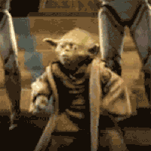
Habituation Packs
4 Different bundles in the first 4 weeks
Each bundle offers a great value to new players
These bundles complement each other but do not necessarily depend on one another
At D28 prepare players with a final package for GW

Slide 14
ow

Slide 15
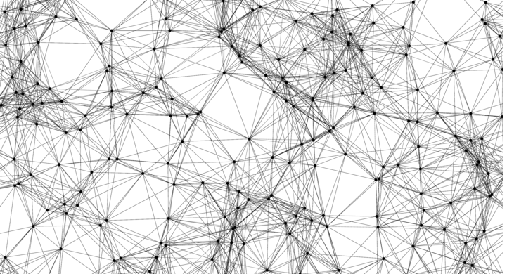
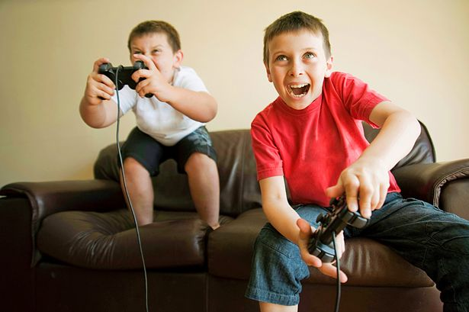
Churn Prediction
Machine Learning
Box

Slide 16
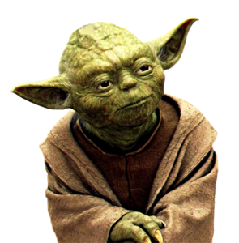
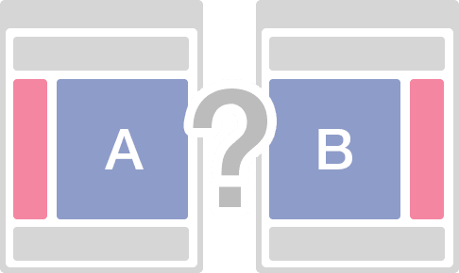
ow

Slide 17
Thank you
ow

