Slide 1

Copyright Basics and
The Public Domain
Martin J. Brennan
UCLA Scholarly Communication
Education Librarian
The following slides are based on the work of the
UCLA Library Scholarly Communications Steering Committee
Notes:
Welcome and introduction of UCLA Librarians / Guest Instructors
Ask attendees to introduce themselves and what they hope to learn/what questions do they have

Slide 2
Objectives
Important Definitions
Materials Covered by Copyright
The “Bundle of Rights”
Duration of Copyright
The Public Domain
Notes:
Ask attendees if they have any other topics that they’d like you to cover

Slide 3
Disclaimer
I am not an attorney, and cannot offer legal advice.
The following information is presented to educate about copyright law and institutional policy in general terms. If you are unclear about your options when confronted with a specific legal issue related to copyright, you are urged to consult with an attorney with a background in copyright law.

Slide 4
Copyright’s legislative evolution
Basic concept of Copyright can be traced to 5th Century Ireland
Modern Origins in British law (Statute of Anne, 1709)
First US law in 1790; many revisions over the years.
The Copyright Act of 1976 is current law, also known as Title 17 of the U.S. Code.
But there have been significant amendments to the law, such as:
- changes spurred by joining the Berne Convention in 1989
- The Digital Millennium Copyright Act (DMCA) of 1998
- the Copyright Term Extension Act of 1998 (the “Sonny Bono Act”)
- the “TEACH Act” of 2002.
Notes:
4
Note that there is (or will be soon) an additional set of teaching materials to explore this history in greater depth – this is just to give some context, and it is not comprehensive

Slide 5
The Copyright Act’s Constitutional Basis
“The Congress shall have Power …To promote the Progress of Science and useful Arts, by securing for limited Times to Authors and Inventors the exclusive Right to their respective Writings and Discoveries.”
  From Article 1, Section 8 of the U.S. Constitution
Notes:
5
In the United States, Congress has a specific constitutional mandate to determine Copyright law.
*Note that the original spirit behind copyright is to promote the progress of art and science, and to limit the exclusive rights afforded by copyright to a reasonable period of time…

Slide 6
“The primary objective of copyright is not to reward the labor of authors, but [t]o promote the Progress of Science and Useful Arts. To this end, copyright assures authors the right to their original expression, but encourages others to build freely upon the ideas and information conveyed by a work. This result is neither unfair nor unfortunate. It is the means by which copyright advances the progress of sciences and art.”
  Justice Sandra Day O’Connor
  FEIST PUBLICATIONS, INC. v. RURAL TEL. SERVICE CO., 499 U.S. 340, 349-50 (1991)
Notes:
6
Justice O’Connor’s views above are consistent with the Constitutional Framers’ intentions, and with the legislative history behind the Copyright Law of 1976. This contrasts with many who view copyright law as a scheme to compensate authors – that is certainly a part of it, but it should properly be viewed as a means to an end, copyright serves a greater societal purpose than that.

Slide 7
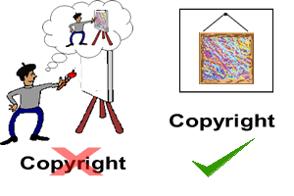
What is covered under Copyright?
§ 102(a) Subject matter of copyright:
original works of authorship
fixed in any tangible medium of expression,
from which they can be perceived, reproduced, or communicated, either directly or with the aid of a machine or device.
Notes:
“Tangible Medium of Expression” includes digital document creation – and indeed every version of a document you save carries its own unique copyright. And it need not be a permanent expression – writings on a chalkboard, or temporary art installations, enjoy copyright protection,
So, from this language in the law, it is clearly understood that copyright is “inherent upon creation.” If you are working on a word document, for example, every time you save the document on your computer, you enjoy copyright protections for that material – indeed such protection could be applied to each and every updated version that you save.

Slide 8

What Works are Protected?
(1) literary works;
(2) musical works, including accompanying words;
(3) dramatic works, including accompanying music;
(4) pantomimes and choreographic works;
(5) pictorial, graphic, and sculptural works;
(6) motion pictures and other audiovisual works;
(7) sound recordings; and
(8) architectural works.
Notes:
8
The earliest copyright laws pertained specifically to books and other written texts. This list of types of materials covered by copyright has evolved over the years to include all these various forms of creative expression.

Slide 9

What is Not Covered
Section 102(b):
any idea,
procedure, process, system,
method of operation,
concept,
principle, or discovery
Works in the public domain
Notes:
It is the medium of expression that is protected by copyright, not the ideas contained within. (Patent protection can protect such things for a limited time, and such rights are granted less frequently and must be applied for.)
**For example, a list of facts, such as the information you’d find in a phone book, is not protected under copyright… nor is a choreographed dance—that is, unless it has been recorded or annotated in some fashion, either filmed or described in some way. Even then, the copyright protection applies to that recording or annotation.

Slide 10
Exclusive Rights of the Copyright Holder
(aka the “Bundle of Rights”)
The copyright holder retains authority to:
Make copies of the work
Make derivative works based on the original work
Distribute the work
Perform the work publicly
Display the work in a commercial setting
The copyright owner may license some or all of these rights to others.
Notes:
The term "copyright" actually refers to a bundle of rights that allow the originator of the work to retain control over certain uses of the work.
**NOTE that this “bundle of rights” can be transferred or licensed to others in whole or in part. Your copyrights can be left to your heirs for the remainder of the copyright term. As an author, your publisher will more than likely ask for a transfer of part or all of your copyrights. It is up to you to negotiate to keep those rights which are important to you…

Slide 11
Works in the Public Domain
“A public domain work is a creative work that is not protected by copyright and which may be freely used by everyone. The reasons that the work is not protected include: (1) the term of copyright for the work has expired; (2) the author failed to satisfy statutory formalities to perfect the copyright or (3) the work is a work of the U.S. Government”
– Laura Gasaway
Notes:
The Public Domain is an important concept for the creation of new works, allowing others to freely reuse the work without permission.

Slide 12
The trouble is…
When do works fall into the public domain?
  Works published in the U.S. before 1924
  Works published by the U.S. Federal Government
  Between 1924-1963: Maybe…
  Unpublished works: Maybe…
It’s complicated!
Notes:
Certainly, most of the materials you will come across in the scholarly world are NOT going to fall in the Public Domain. You must begin with the assumption that any original work of authorship is protected by copyright.
Works produced from 1923 through 1963 may still be covered by copyright if the copyright owner renewed that copyright under revisions to copyright over the years. It’s estimated that 90% of these works WERE NOT RENEWED. However, to be sure, one must confirm the copyright status of such objects.

Slide 13
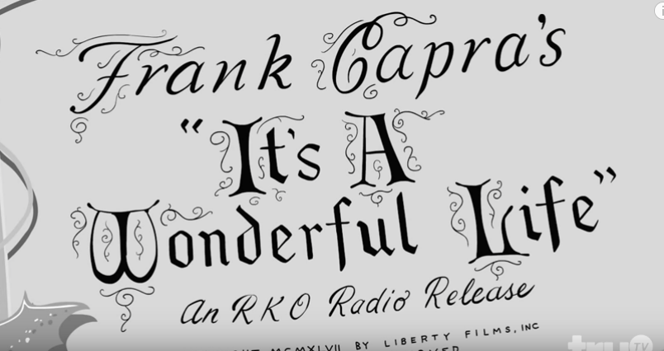
https://www.youtube.com/watch?v=fEq9sdKbYhU

Slide 14
Copyright has evolved in many ways
Copyright Term has extended
At certain points, renewal was necessary (not anymore)
Notices and registration practices have changed
Types of rights, and materials covered, has expanded
Public Domain has become a valued principle
Fair Use continues to find its boundaries
International agreements have grown more robust and complex
Excerpted from: http://www.loc.gov/teachers/copyrightmystery/text/files/
Notes:
Again, to summarize: copyright law we now operate under have developed over time, as a response to evolving forms of original expression (images, motion pictures, etc.) and the pressure from corporate owners of copyrighted material (the extended copyright term). The dates and particular laws are not important to remember per se – what’s important to know is the 1976 act and its amendments since then. This historical overview is really only useful to provide context for the current law.

Slide 15
Copyright Notice no longer required
Prior to March 1, 1989: © notice required
After March 1, 1989 : © notice optional
…but still highly recommended
Notes:
As originally enacted, the 1976 law prescribed that all visually perceptible published copies of a work, or published phonorecords of a sound recording, should bear a proper copyright notice. This applies to such works published before March 1, 1989.
After March 1, 1989, notice of copyright on these works is optional. Adding the notice, however, is strongly encouraged and, if litigation involving the copyright occurs, certain advantages exist for publishing a work with notice.
Prior to March 1, 1989, the requirement for the notice applied equally whether the work was published in the United States or elsewhere by authority of the copyright owner. Compliance with the statutory notice requirements was the responsibility of the copyright owner. Unauthorized publication without the copyright notice, or with a defective notice, does not affect the validity of the copyright in the work.

Slide 16
Copyright Term Extension
Initial Term - 14 years
1962 59 years
1965 61 years
1967 62 years
1969 63 years
1970 64 years
1971 66 years
1972 68 years
1974 70 years
1976 75 years
1998 - 95 years
Notes:
16
This gives you a snapshot of how content owners (Publishers, Distributors, etc.) have consistently pushed the copyright term to the current length over the course of the 20th century. Indeed, the Copyright Extension Act of 1998 extended the term of copyright by 20 more years. These changes in the law were prompted in large part by the Disney Company, who constantly pushed the envelope of copyright protection to protect Mickey Mouse from falling into the Public Domain.

Slide 17
Current Copyright Term
For most works produced in the US since 1/1/1978*:
  For Works by an individual author:
  Life of the Author + 70 Years
  For Corporate Works:
  95 years from publication, or
  120 years from creation,
  whichever expires first
*items produced from 1978 through 3/1/89 that were published without a copyright notice, and without subsequent registration within 5 years, are now in the Public Domain.
Notes:
17
Given all the caveats in the previous slides, this current formulation of copyright term should be assumed when handling anything produced in the United States, until you determine otherwise.

Slide 18
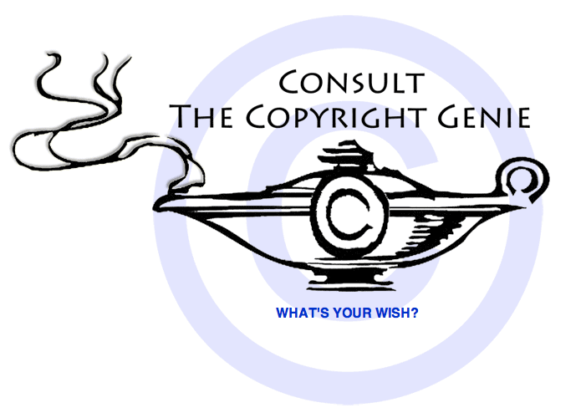
The “Copyright Genie” for
Determining Copyright Status
http://librarycopyright.net/resources/genie/
From the ALA Office for Information Technology Policy
Notes:
18
This tool can make it easy to determine the Copyright status of works created in the United States.

Slide 19
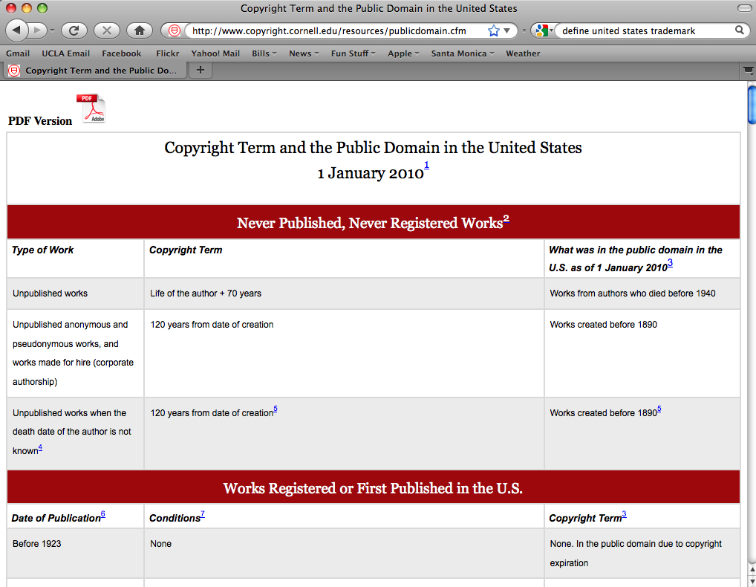
Notes:
19
This chart by Peter Hirtle at Cornell, kept updated to reflect any changes to US or international law, carefully covers differing types of materials. It details how the specific publication date determines the length of the copyright term, and if/when the material will enter the public domain under current law. A PDF of this chart is available to use as a handout.
http://www.copyright.cornell.edu/resources/publicdomain.cfm

Slide 20
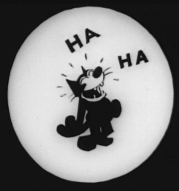
Items published in the U.S. in 1923 entered the Public Domain
On Jan 1, 2019

Slide 21
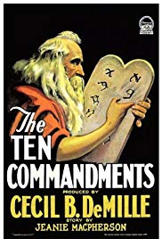
Cecil B. DeMille’s (first, less famous, silent version of) The Ten Commandments

Slide 22
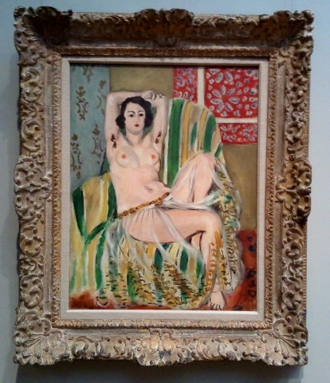
Henri Matisse, Odalisque Seated with Arms Raised, Green Striped Chair, oil on canvas, 1923

Slide 23
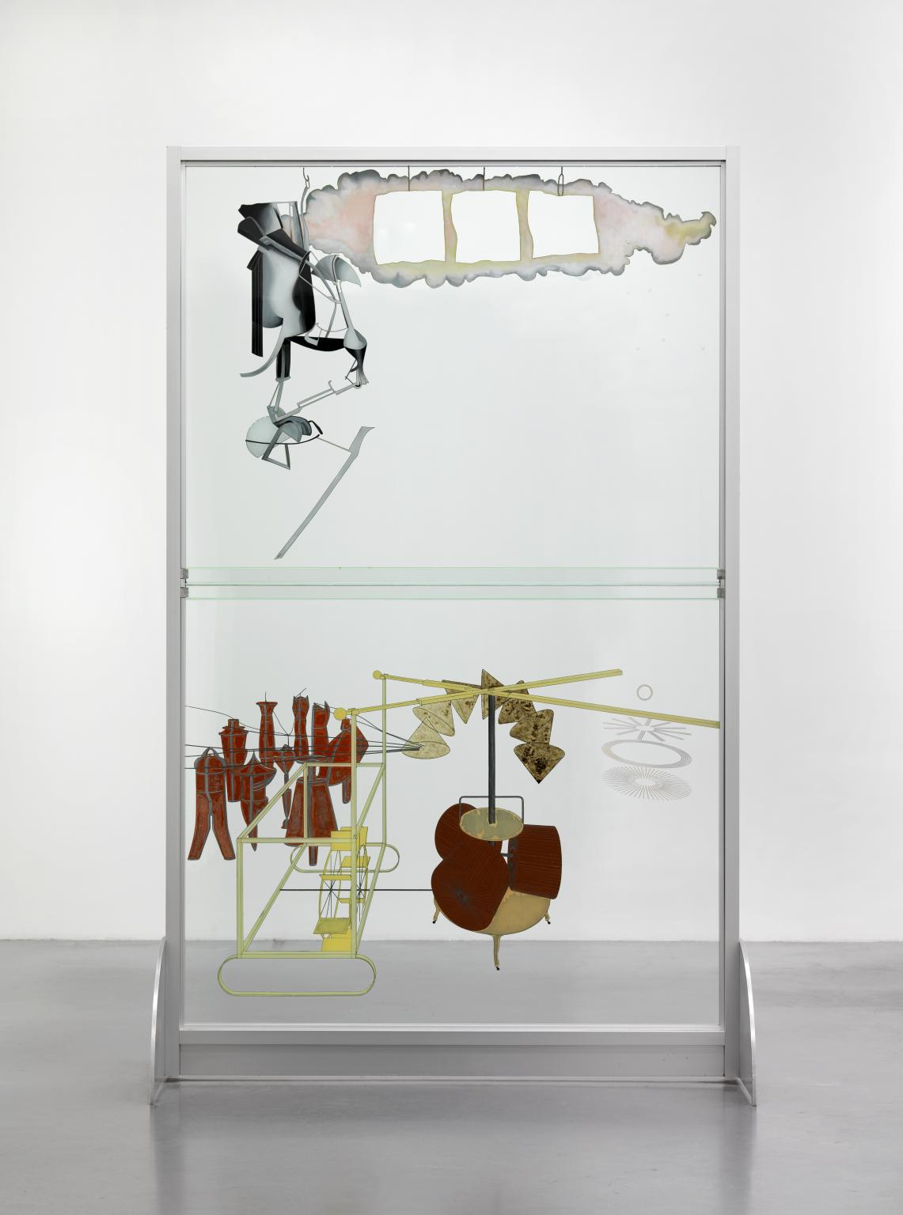
Marcel Duchamp’s The Bride Stripped Bare By Her Bachelors, Even (The Large Glass)

Slide 24

Saint Joan, by George Bernard Shaw

Slide 25
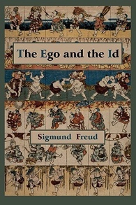
The Ego and the Id, by Sigmund Freud

Slide 26
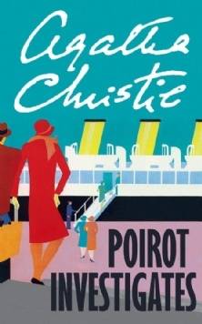
Two of Agatha Christie’s Hercule Poirot novels,
The Murder of Roger Ackroyd and The Murder on the Links

Slide 27
Hathi Trust 1923 collection
Opened access to a collection of over 53,000 works including novels, poems, journals, research volumes, and musical scores published in the United States in 1923

Slide 28
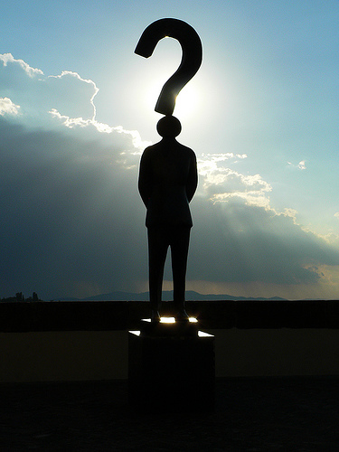
Questions?
Thank You!
Acknowledgements
The preceding slides are based on the work of the
UCLA Library Scholarly Communications Steering Committee
Photo from flickr: http://www.flickr.com/photos/marcobellucci/3534516458/

Slide 29
In Partnership with UCLA Library
FORCE11 Scholarly Communications Institute
August 5–9, 2019 • UCLA, Los Angeles, CA
www.force11.org/fsci/2019

