Slide 1

Fair Use & the Academy
Kyra Folk-Farber
Head, Music Library (Acting), University of California, Santa Barbara

Slide 2
Outline
What is fair use?
Why does it matter?
How can work be used fairly?
Is it fair use? You be the judge.

Slide 3
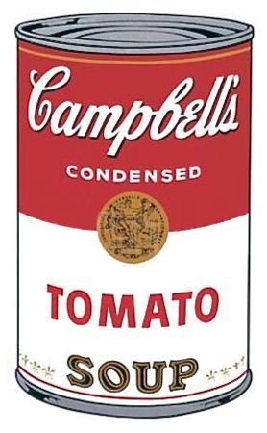
Outcomes
Recognize the place of fair use in scholarship and teaching.
Understand how to do a fair use analysis.
Campbells Soup I (set of 10)
1968
by Andi Warhol

Slide 4
Exceptions
107. Fair use
108. Reproduction by libraries and archives
109. Effect or transfer of particular copy or phonorecord
110. Exemption of certain performances and displays
111. Secondary transmissions of broadcasts programming by cable
112. Ephemeral recordings
ETC.
1201 – DMCA
TEACH Act

Slide 5
Fair Use
107. Limitations on exclusive rights: Fair use
Notwithstanding the provisions of sections 106 and 106A, the fair use of a copyrighted work, including such use by reproduction in copies or phonorecords or by any other means specified by that section, for purposes such as criticism, comment, news reporting, teaching (including multiple copies for classroom use), scholarship, or research, is not an infringement of copyright. In determining whether the use made of a work in any particular case is a fair use the factors to be considered shall include—
(1) the purpose and character of the use, including whether such use is of a commercial nature or is for nonprofit educational purposes;
(2) the nature of the copyrighted work;
(3) the amount and substantiality of the portion used in relation to the copyrighted work as a whole; and
(4) the effect of the use upon the potential market for or value of the copyrighted work.
The fact that a work is unpublished shall not itself bar a finding of fair use if such finding is made upon consideration of all the above factors.

Slide 6
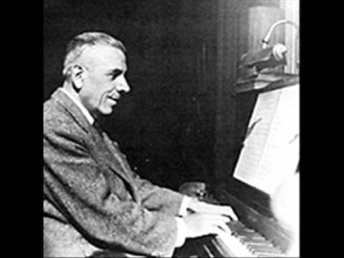
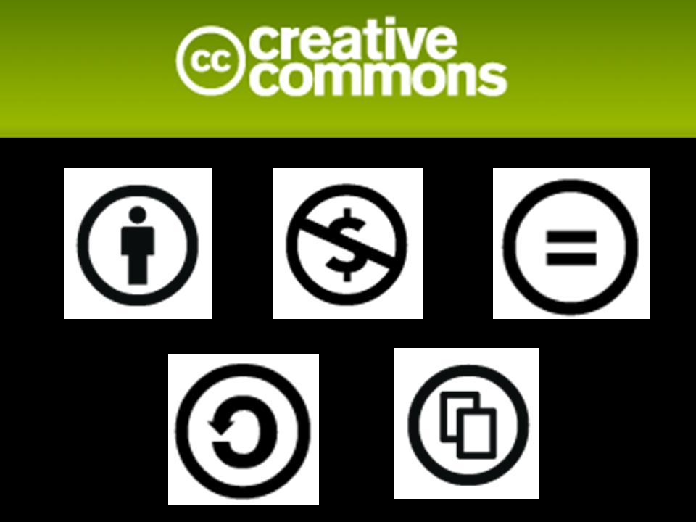
Fair Use is NOT:
Permission
Public domain
Creative Commons
Attribution
Another exception in copyright law
Francis Poulenc
1899-1963

Slide 7
Responsible Copyright Stewardship
Scholarship
Use
Own
Use
Own

Slide 8
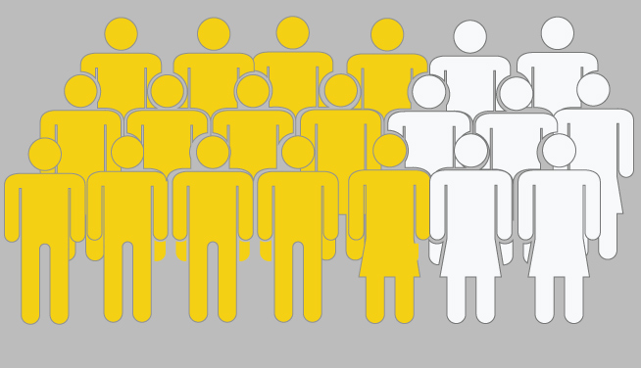
Code of Best Practices
in Fair Use for the Visual Arts
WHY IT MATTERS: 2014 CAA ISSUES REPORT
70% of respondents say they use copyrighted
material in doing their own work
Notes:
Here’s why fair use is important to members of the visual arts community: Most of them use copyrighted material in their work, and sometimes they do not need to ask permission to use it. It’s important in terms of efficiency, finances and most importantly, hewing to the mission of their work that they know when they need to get permission and when they don’t.

Slide 9
Is it fair use?
In determining whether the use made of a work in any particular case is a fair use the factors to be considered shall include—
(1) the purpose and character of the use, including whether such use is of a commercial nature or is for nonprofit educational purposes;
(2) the nature of the copyrighted work;
(3) the amount and substantiality of the portion used in relation to the copyrighted work as a whole; and
(4) the effect of the use upon the potential market for or value of the copyrighted work.

Slide 10
Fair Use Factors
Purpose & character of use;
Nature of copyrighted work;
Amount & substantiality of the portion taken;
Effect of use on the potential market.
Ask yourself:
is it TRANSFORMATIVE?

Slide 11
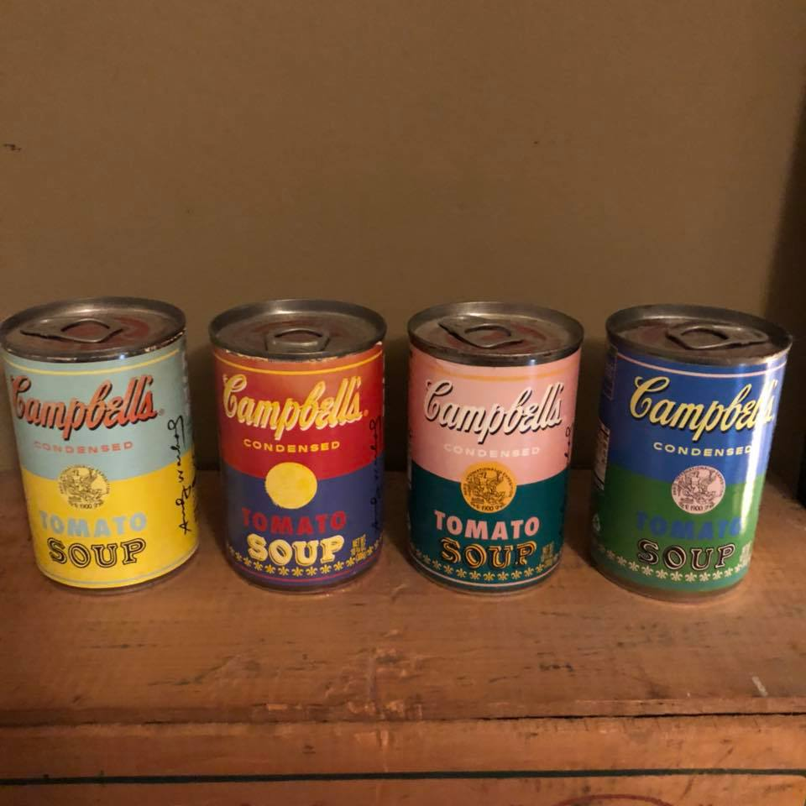
Fair Use Checklist

Slide 12
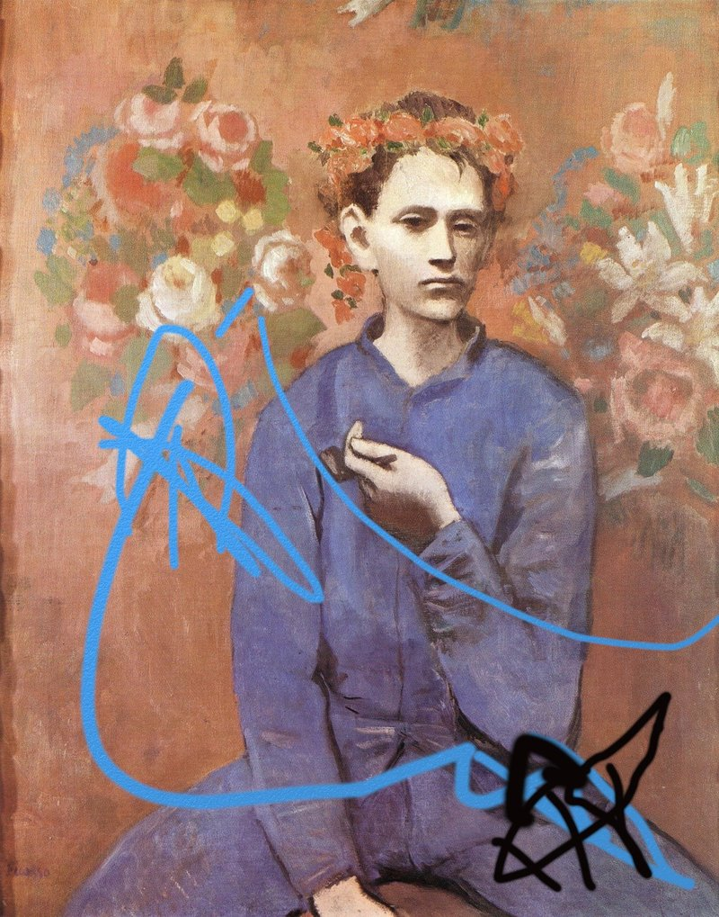
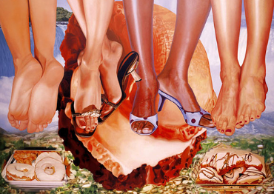
Code of Best Practices
in Fair Use for the Visual Arts
Notes:
New art and art projects may build on existing art, and projects like digital exhibits may use existing art for different purposes than the original market. These are transformative purposes.

Slide 13
Is It Fair Use?

Slide 14
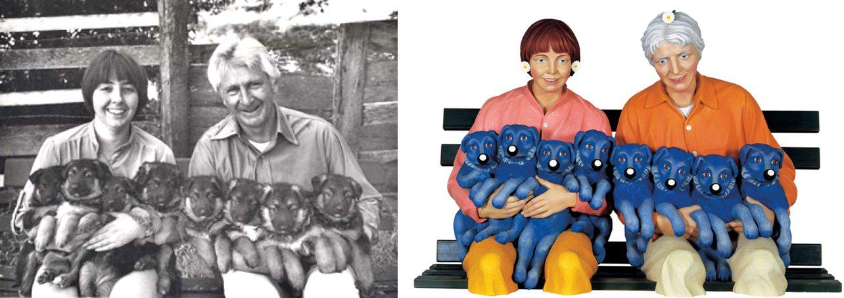
Is It Fair Use?
Left: Photo by Art Rogers, Puppies, 1985 Right: Sculpture by Jeff Koons, String of Puppies, 1988

Slide 15
Is It Fair Use?
Scenario 1
Faculty makes 35 copies of a poem from an anthology and distributes the copies to her students. She is teaching a class on poetic form.
Scenario 2
Scholar uses a thumbnail image of a photo from The New York Times to illustrate a point for his book project.

Slide 16
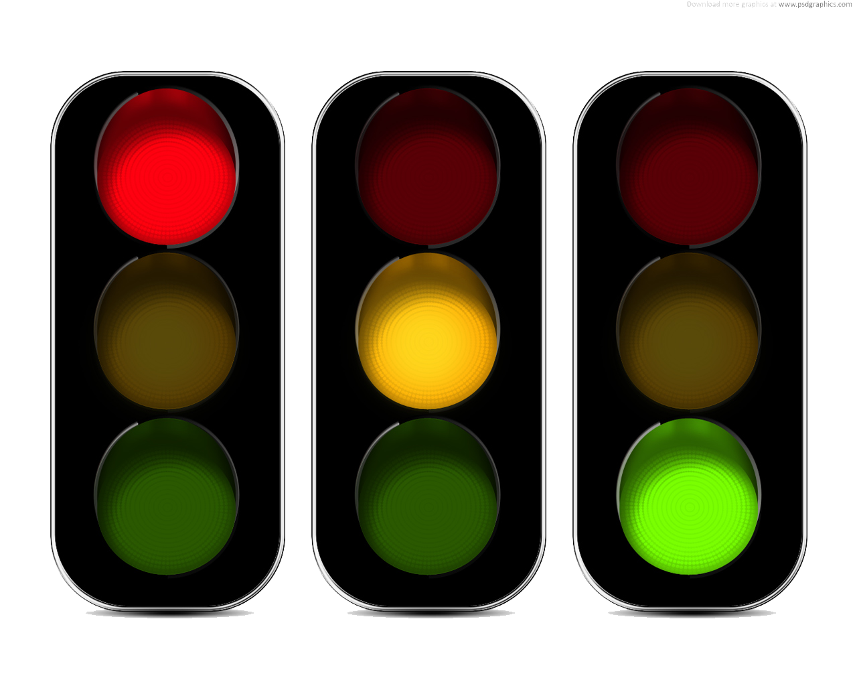
Risk assessment

Slide 17
Resources
CSU Northridge Copyright LibGuide
UCSB Library Copyright & Fair Use Guide
CMSI – Center for Media & Social Impact: Codes of Best Practices in Fair Use
Kyra Folk-Farber
kfolkfarber@ucsb.edu

