Slide 1
The Oviatt Library and the Bonita J. Campbell Endowment for Women in Science and Engineering Welcome You to
STEM: Education Challenges and Career Opportunities

Slide 2
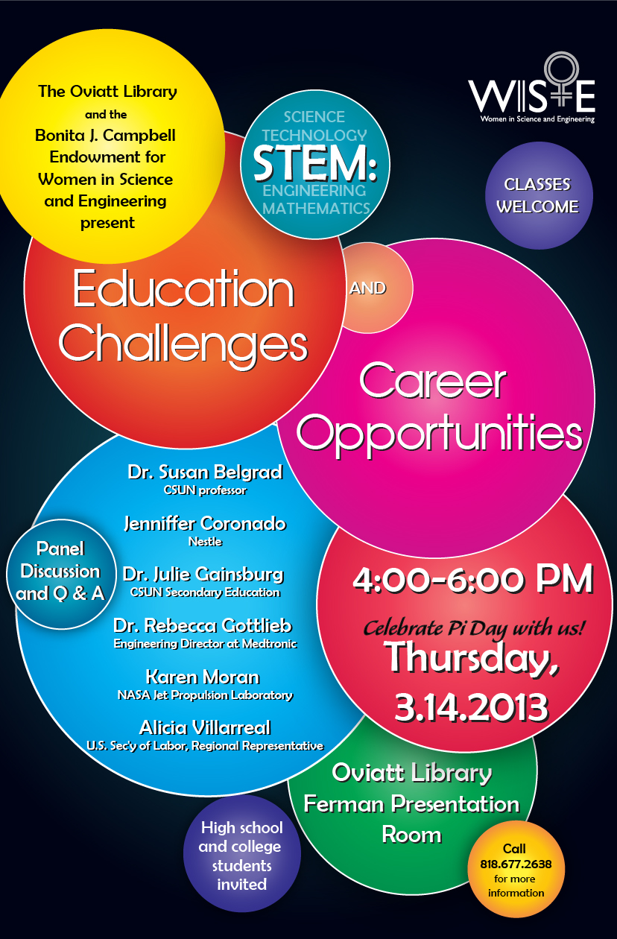

Slide 3
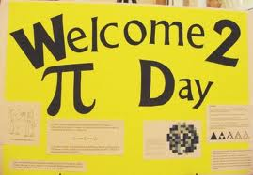

Slide 5
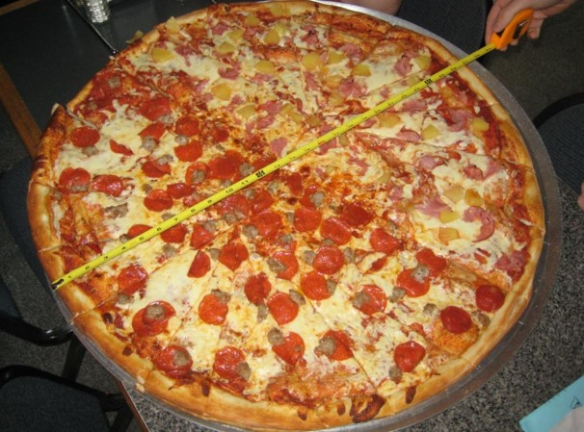

Slide 6
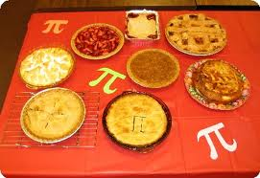

Slide 7
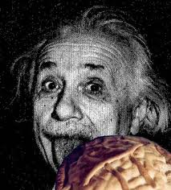

Slide 8
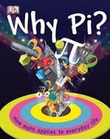

Slide 9
A PI-Day
Activity
Let’s do Π

