Slide 1
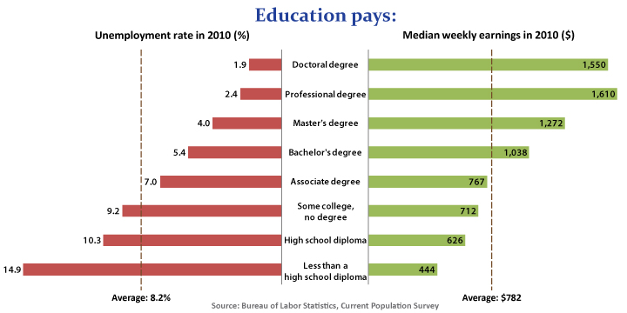
Education equals lower unemployment and more $

Slide 4
Picture Remains Bleak for
Lower Income Workers
Source: PPIC calculations from US Census Bureau data

