Slide 1
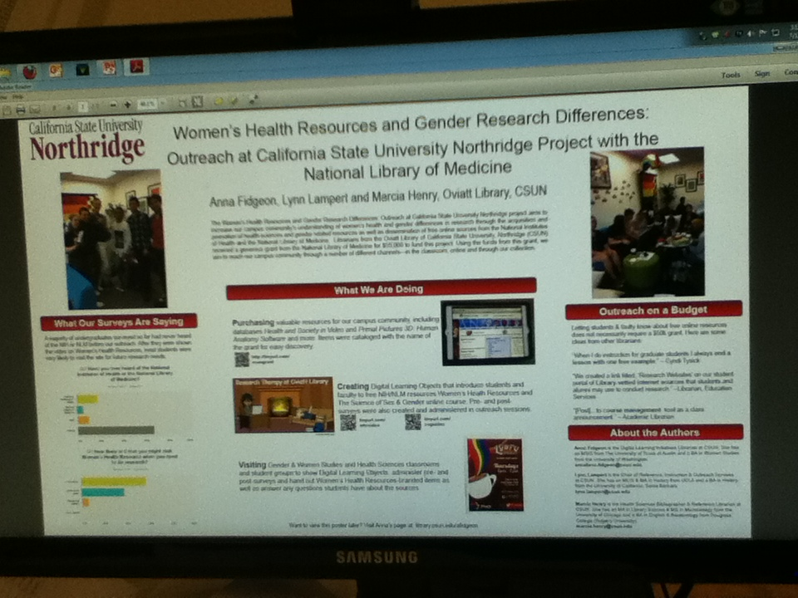
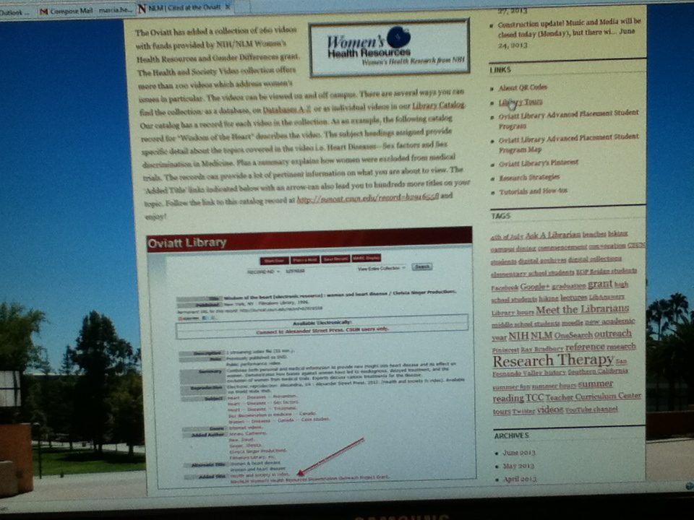
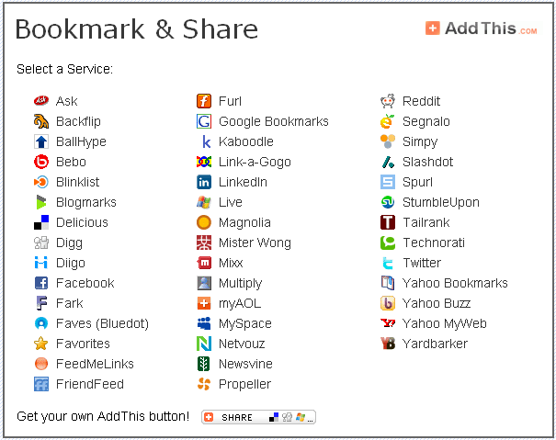
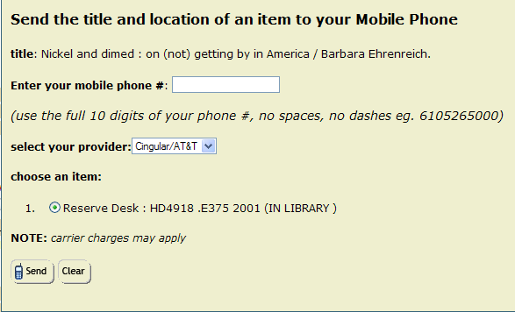
Riding the Wave: Grant opportunity expands Marcia Henry, Health Sciences Librarian Analise Fidgeon, Lynn Lampert California State University, Northridge
Outreach programs
1
Organizations
Classes
Social Media
5
2
3
4
Collections
Purchasing
Cataloging
Metadata
Promoting
1
2
4
3
5
6
This Poster highlights CSU Northridge’s grant proposal to the NIH/NLM Office of Outreach Services early January 2013 The title of our project is “Women’s Health Resources and Gender Research Differences: Outreach at California State University Northridge” and it must be completed by September 15, 2013. This short, intense project proposed to do the following: Create digital learning objects (DLO’s) to promote

